Slide 1
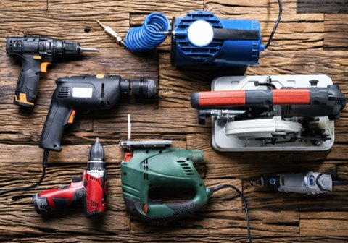
Power Tools Safety
To reduce the chance of an accident​
Always use the right tool for the job.
Wear proper personal protective equipment (PPE).
Never use tools with worn or damaged cords.
Always use guarding and do not modify the tool.
Unplug tools when not using them, before servicing or cleaning, and when changing accessories such as blades, bits, and cutters.
Avoid accidental starting. Keep fingers away from switches or triggers while carrying power tools, and ensure switches are in the off position.
Avoid loose clothes, jewelry, or unrestrained long hair that could be pulled into moving equipment
1
Notes:
Keep all people not involved with the work at a safe distance from the work area.
Maintain proper footing and balance.
Avoid loose clothes, jewelry, or unrestrained long hair that could be pulled into moving equipment.

