Slide 1
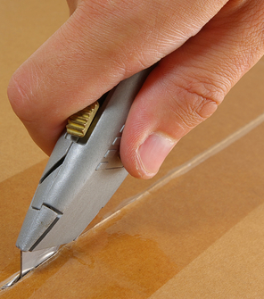

Box Cutter Safety

Slide 2
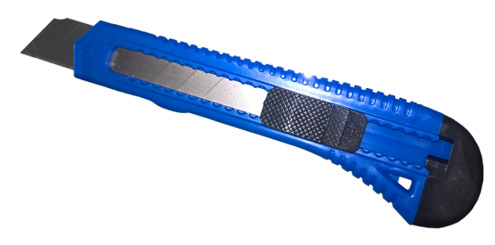
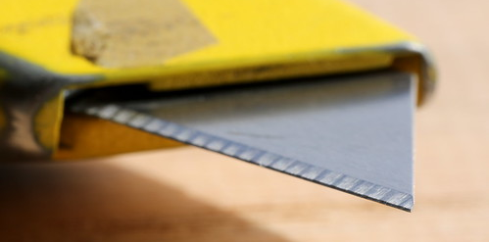
Box cutter knives
A box cutter knife is a type of utility knife used for cutting cardboard, plastic, tape, paper, and similar materials, making it handy for opening packages.
A box cutter knife usually has a retractable blade that can be exposed or hidden by sliding a sleeve on the handle.
Some box cutter knives have snap-off blades that can be broken off when they become dull.
Blade safety
Watch the blade at all times and do not get distracted by other tasks or people.
Wear gloves and other protective equipment when handling box cutters.
Angle the box cutter away from your body and make sure no body parts are in the cutting path.
Keep the blade as short as possible and retract it when not in use.
Dispose of dull or damaged blades in a puncture-resistant container.
This Photo by Unknown Author is licensed under CC BY-SA-NC

