Slide 1
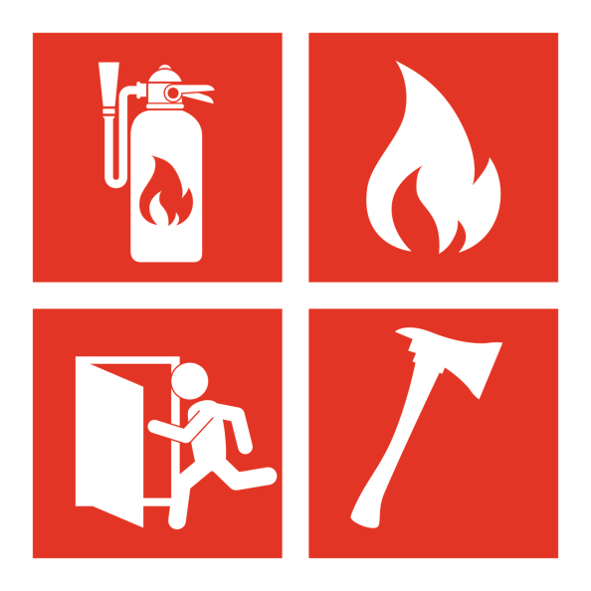
Fire protection and prevention

Slide 2
Fire protection and prevention
The main fire protection concerns include:
Fire prevention
The prevention of fires is of utmost importance. Common concerns include proper housekeeping to eliminate the accumulation of flammable materials, ensuring proper storage and handling of hazardous substances, regular inspection and maintenance of electrical systems, and adherence to fire safety protocols and procedures.
Fire detection and alarm systems
Early detection of fires is critical for prompt response and evacuation. Concerns in this area include the proper installation, maintenance, and testing of fire detection systems such as smoke detectors, heat detectors, and fire alarms. Ensuring the integration and functionality of these systems with the overall fire protection infrastructure is essential.
Fire suppression systems
Fire suppression systems play a vital role in quickly and effectively extinguishing fires or containing their spread. Concerns include the installation, maintenance, and inspection of systems such as sprinklers, fire extinguishers, fire hoses, and automatic fire suppression systems. Proper training of employees in the use of fire extinguishers is also crucial.

Slide 3
Fire protection and prevention
The main fire protection concerns include:
Emergency Response Planning
Having comprehensive emergency response plans is essential to address potential fire incidents. Concerns include establishing clear evacuation procedures, designating assembly points, conducting regular drills and training sessions, and ensuring employees are aware of emergency exits and evacuation routes.
Electrical Fire Safety
Electrical malfunctions are a significant cause of industrial fires. Concerns include proper installation, maintenance, and inspection of electrical systems; identifying and addressing potential electrical hazards; and ensuring compliance with electrical safety standards and regulations.
Hazardous Materials Handling
Industries dealing with hazardous materials must have proper storage, handling, and disposal procedures in place. Concerns include implementing appropriate containment systems, providing sufficient ventilation, training employees on the safe handling and storage of hazardous materials, and ensuring compliance with relevant safety regulations.

