Slide 1
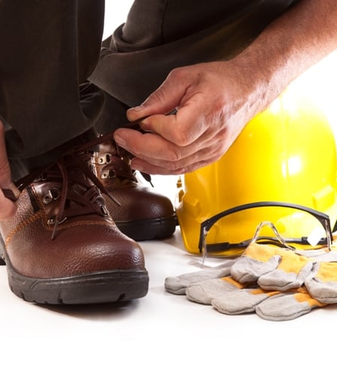

Foot Protection

Slide 2
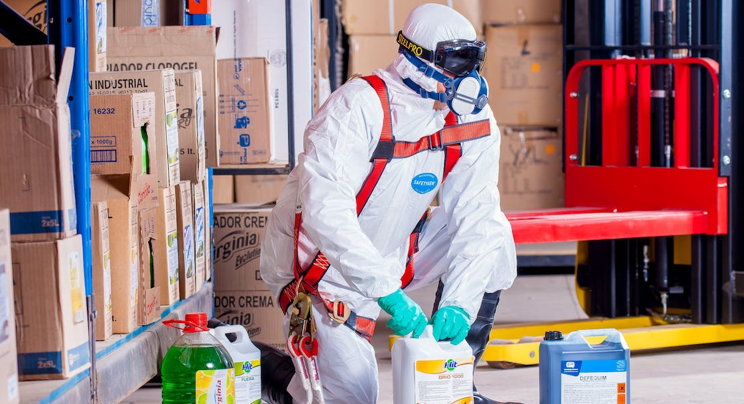
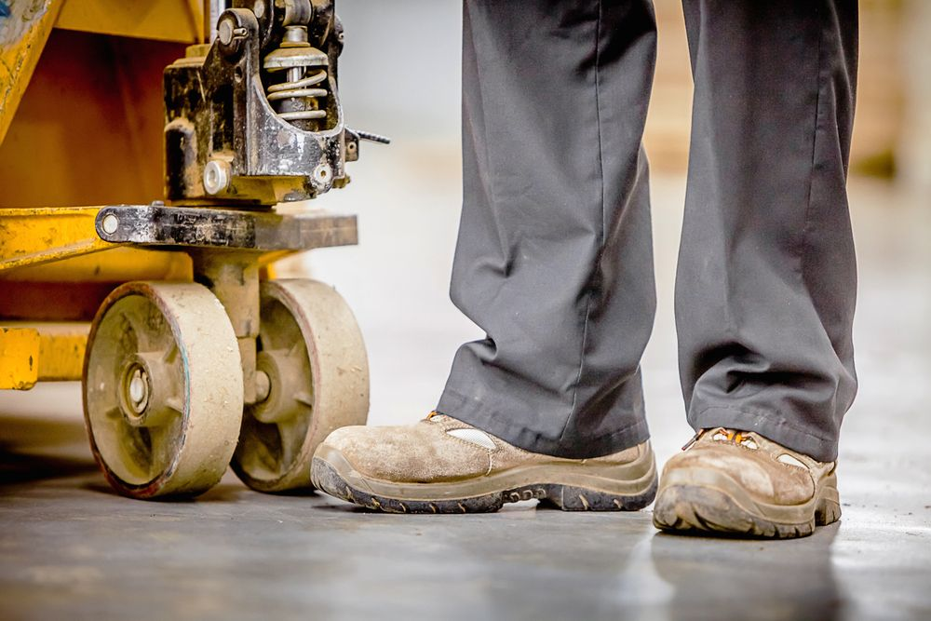
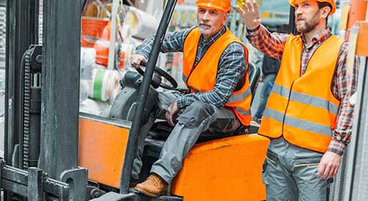
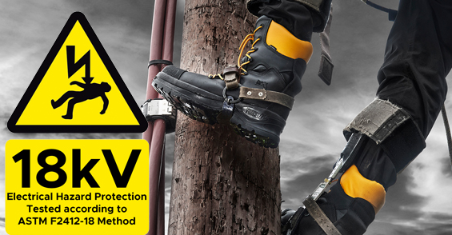
When foot protection is required:
Hazardous materials or substances
Falling or rolling objects
Heavy machinery and equipment
Electrical hazards
If you deal with chemicals, corrosive substances, or biohazards, you are often required to wear foot protection to prevent exposure to harmful substances.
Chemical-resistant boots can provide a barrier against splashes, spills, or leaks that could otherwise cause skin damage or contamination.
Objects falling from heights or rolling on the ground can pose a significant danger to the feet.
If your job involves dealing with falling or rolling objects, safety shoes or boots with reinforced toes and sturdy soles can help protect against injuries such as fractures, crushes, or punctures.
Workplaces with heavy machinery or equipment require foot protection.
Steel-toed boots or safety shoes with metatarsal guards can shield the feet from impact, crushing, or compression injuries that may result from accidental contact with heavy objects or machinery.
Electrical work and exposure to live wires pose a risk of electrical shocks or electrocution.
Electrically insulating footwear, such as dielectric boots, is necessary to prevent electrical current from passing through the feet and into the body. This offers protection against electrical accidents and maintains electrical safety protocols.
Contact your local OHS team to see if foot protection is required for your job. Email us at ASKOHS@Microsoft.com
Notes:
Drink plenty of fluids during vigorous or outdoor activities (including sunbathing), especially on hot days. Drinks of choice include water and sports drinks; avoid alcohol and fluids with caffeine, such as tea, coffee, and cola, as these can lead to dehydration.
dresses in light colored, lightweight, tightly-woven, loose-fitting clothing on hot days.
Schedule vigorous activity and sports for cooler times of the day. Take rest periods in shady or cool areas.
Increase time spent outdoors gradually to get your body used to the heat.
take frequent drink breaks and "wet down" or mist themselves with a spray bottle to avoid becoming overheated.
Try to spend as much time indoors as possible on very hot and humid days.

