Slide 1
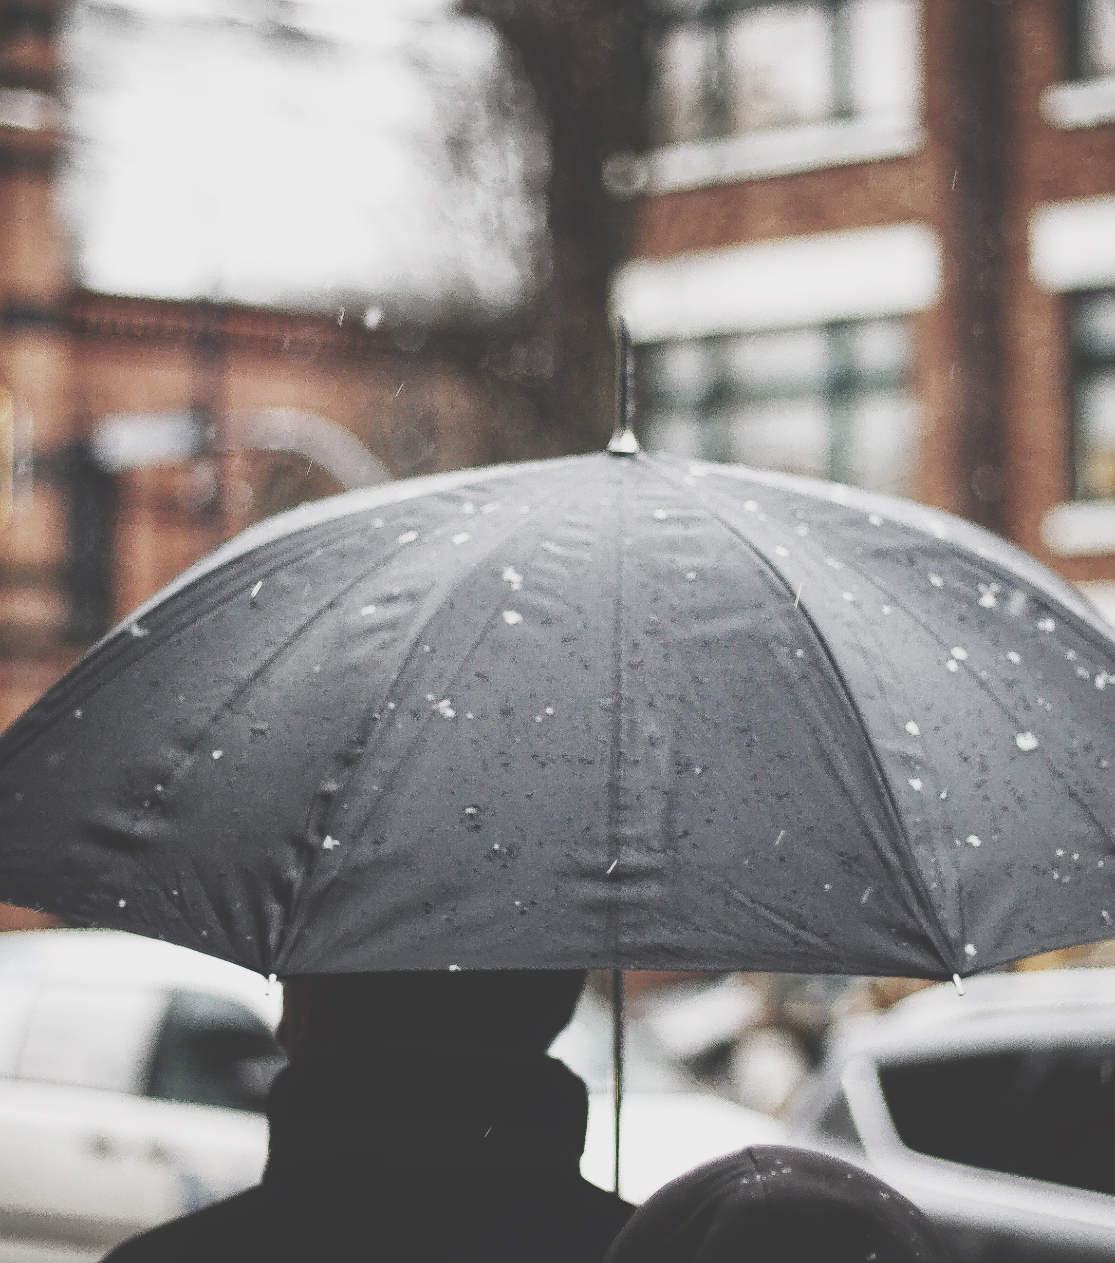

Inclement Weather

Slide 2
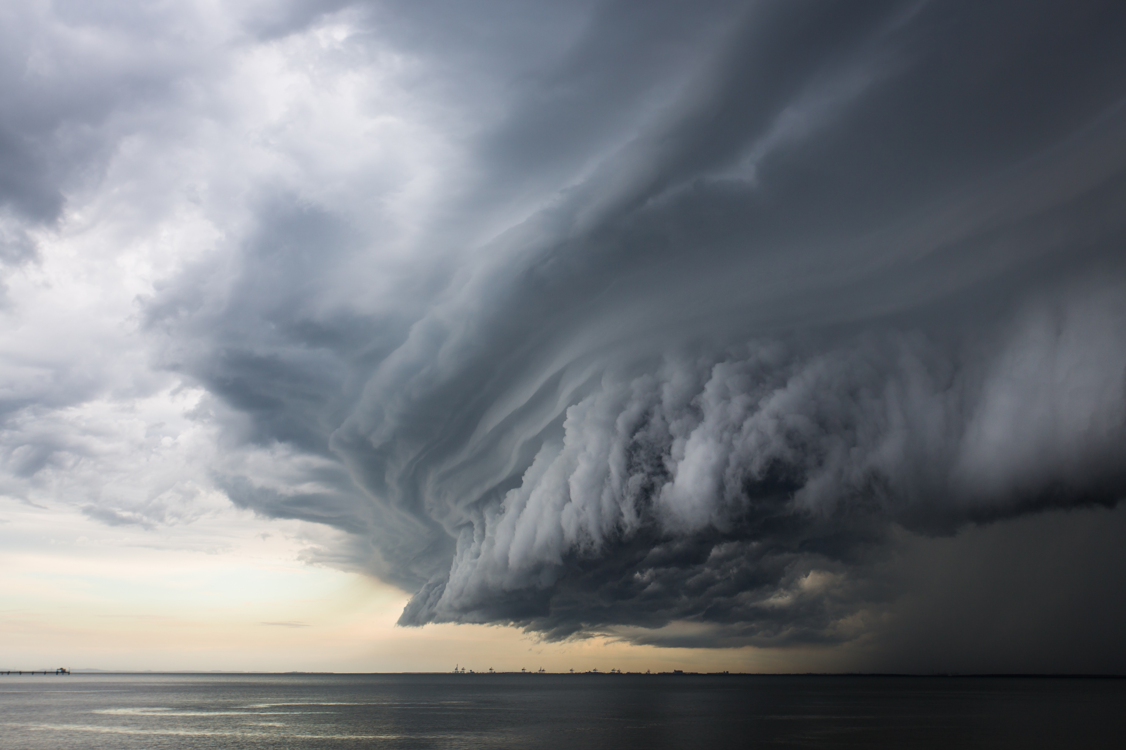
Inclement weather
Inclement weather can pose a risk to the safety of employees and customers. Inclement weather can include rain, snow, ice, wind, thunderstorms, tornadoes, hurricanes, and other extreme conditions.
Some of the hazards associated with inclement weather are slippery floors, falling objects, power outages, flooding, and structural damage.

Slide 3
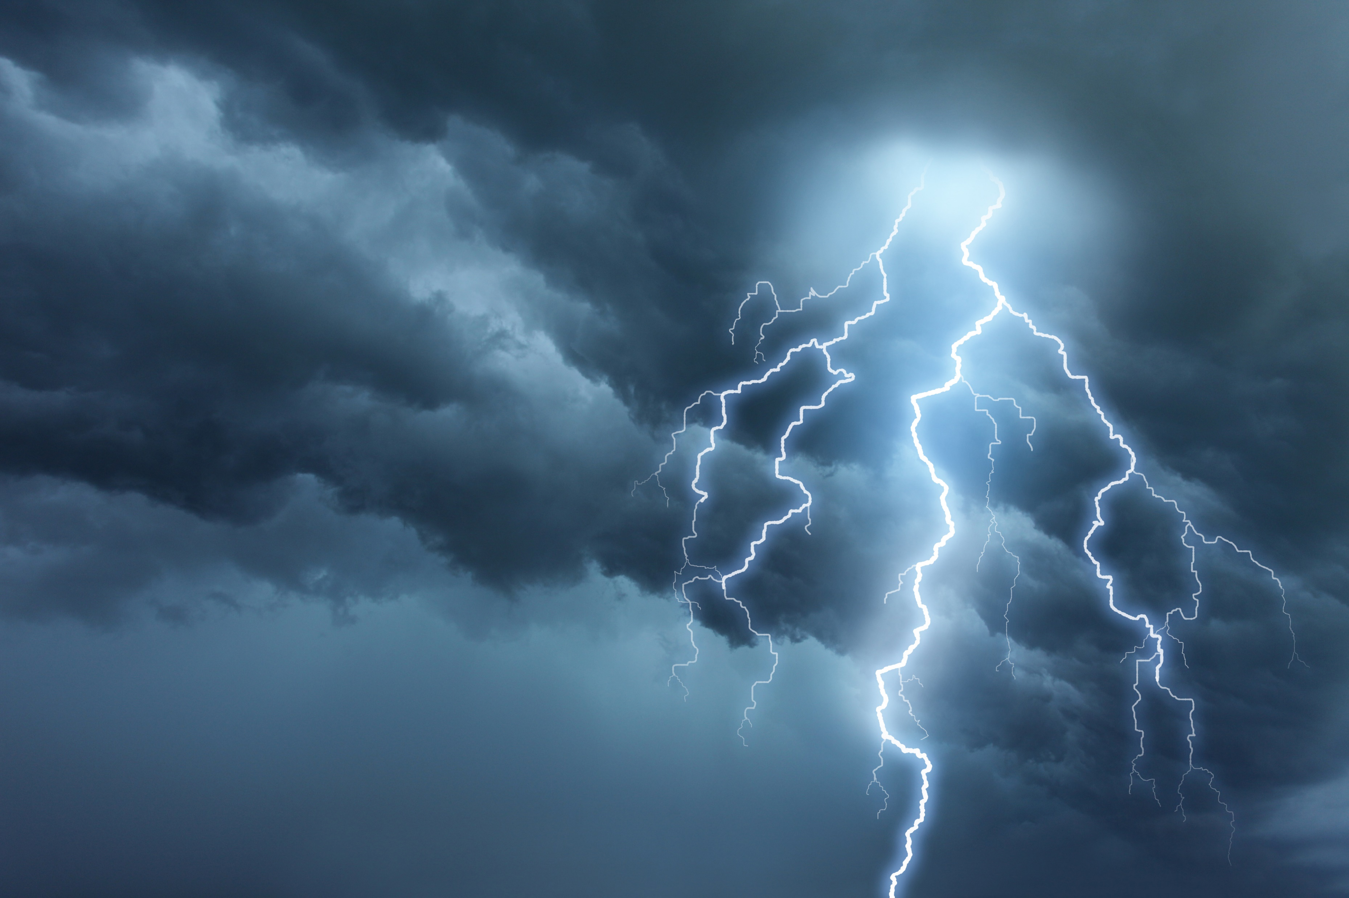


What is it?
"Inclement weather" refers to weather conditions that are unfavorable or unpleasant, such as heavy rain, strong wind, snow, hail, or thunderstorms. Inclement weather can cause disruptions to transportation, communication, power supplies, and other services. It can also pose risks to human health and safety as well as to property and infrastructure.
Impact
Inclement weather can have a significant impact on retail sales depending on its type, severity, and timing. Retailers need to plan ahead and adapt to changing weather conditions to minimize disruptions and losses. Inclement weather can affect both the demand and supply of retail goods as well as the shopping experience and behavior of customers. Retailers can use advanced weather intelligence and risk management practices to prepare for and respond to severe weather events.
This Photo by Unknown Author is licensed under CC BY

Slide 4
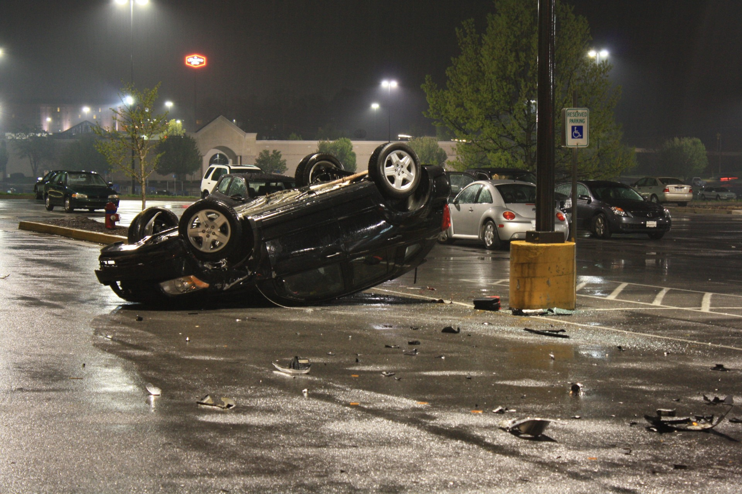
Prevention
Monitor the weather forecast and alerts regularly and plan accordingly.
Keep the store entrance and exit clear of snow, ice, water, debris, and other obstacles.
Use mats, signs, cones, or barriers to warn customers of wet or slippery floors.
Secure shelves, displays, signs, and other items that could fall or fly due to strong winds or vibrations.
Have an emergency plan and kit ready in case of power outages, flooding, or evacuation.
Train employees on how to respond to different types of inclement weather scenarios and emergencies.

