Slide 1


Micro Breaks

Slide 2
Micro Breaks
The Importance of Micro Breaks in Preventing Musculoskeletal Disorders (MSDs)
MSDs are a leading cause of workplace injuries and can result in significant discomfort, reduced productivity, and increased absenteeism. These disorders often develop over time due to repetitive strain, poor posture, and prolonged static positions. Implementing regular micro breaks is a simple yet effective strategy to prevent MSDs, especially in environments where employees are engaged in repetitive tasks or remain in one position for extended periods.
2

Slide 3
Micro Breaks
The Role of Micro Breaks
Micro breaks, also known as short breaks, are brief pauses taken throughout the workday. These breaks are crucial in interrupting prolonged periods of static postures and repetitive movements, which are primary risk factors for MSDs. Micro breaks allow the body to recover and reduce the accumulation of strain on muscles and joints.
It is recommended that office workers take 1–2 minute micro breaks every 30 minutes to stretch, change posture, or walk briefly, which helps prevent muscle fatigue and reduces the risk of ergonomic injuries.
3

Slide 4
Benefits of Micro Breaks
Reduction in Muscle Fatigue
Improved Blood Circulation
Enhanced Posture
Increased Productivity and Focus
Regular micro breaks help to alleviate muscle fatigue by allowing the muscles to relax and recover from the strain of repetitive tasks or sustained postures.
Taking a break promotes blood flow, which helps deliver essential nutrients to muscles and tissues, reducing the risk of injury.
Micro breaks provide an opportunity to correct posture and reset the body’s alignment, preventing the development of poor posture-related issues.
By preventing the onset of discomfort and fatigue, micro breaks can improve overall productivity and mental focus.

Slide 5
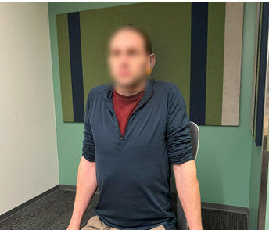
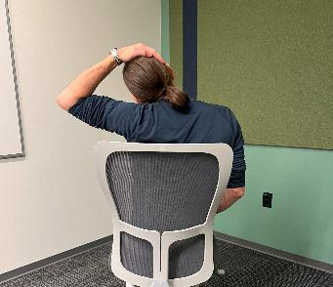
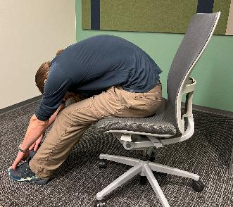
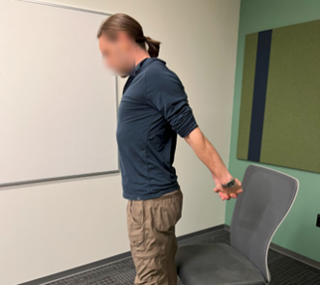
Stretching Exercises
Shoulder Shrugs
Neck Stretch
Seated Forward Bend
Chest stretch
Sit or stand up straight.
Lift both shoulders up towards your side of your head, hold for a moment, and then relax your shoulders down.
Repeat 10 times to release tension in your neck and shoulders.
Sit or stand up straight.
Slowly tilt your head to the right, bringing the side of your head towards your shoulder. Hold for 5-10 seconds.
Repeat on the left side.
You can enhance the stretch by gently pulling your head closer to your shoulder with your hand.
Sit at the edge of your chair with your feet flat on the floor.
Slowly bend forward and reach down towards the floor.
Let your head and neck relax, holding the stretch for 5-10 seconds.
Stand with your feet hip-width apart.
Extend your arms behind you and interlock your hands.
Gradually press and lift your hands away from your body, drawing your shoulder blades together.

Slide 6
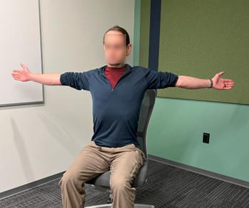
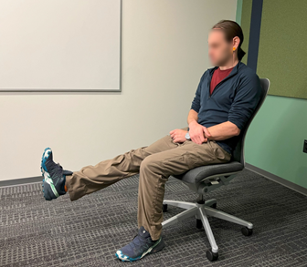
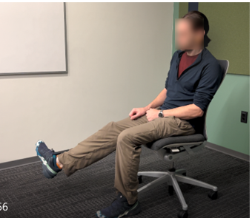
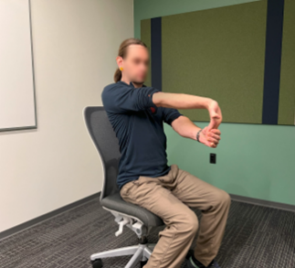
Stretching Exercises
Chest Opener
Leg Extension
Ankle Circles
Wrist Flexor and Extensor
Stand with your feet hip-width apart.
Inhale and open your arms out and back.
Feel your chest and shoulders open as you take in several deep breaths from your stomach.
Hold the stretch for 5-10 seconds.
Sit in your chair with your feet flat on the floor.
Extend one leg out straight, flexing your foot so your toes point upward.
Hold for a few seconds, then lower your leg back down.
Repeat 10 times for each leg.
While seated, lift one foot off the floor.
Slowly rotate your ankle in circles, first clockwise, then counterclockwise.
Perform 10 circles in each direction, then switch to the other foot.
Extend one arm in front of you, palm facing up.
Use your other hand to gently pull back your fingers, stretching the wrist and forearm. Hold for 5-10 seconds.
Return to the starting position. With palm facing down, gently pull your extended fingers back toward your body. Hold for 5-10 seconds.
Repeat on the other hand.

Slide 7
Thank you

