Slide 1

Lessons Learned:
Slips, Trips, and Falls

Slide 2
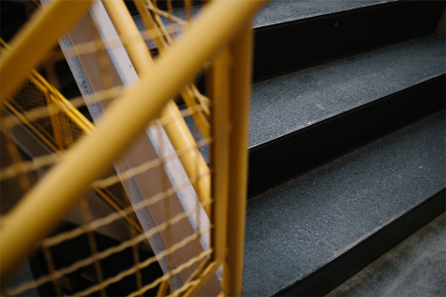


Hazard Awareness
In March of 2023, an employee tripped down the stairs and sprained their ankle.
Slips, trips, and falls, make up most general industry accidents. They are one of the most frequent types of reported injuries, about 23% of reported claims per fiscal year. Slips, trips, and falls can happen in any part of the workplace, inside, or outdoors.
Lessons Learned
Sometimes slips, trips, and falls happen but they can be prevented. Keep the workplace clean and tidy. Watch for items that can become tripping hazards, such as trash, boxes, unused materials, extension cords, tools, carts, and ensure file cabinet drawers are closed. When walking down or up the stairs use the handrail. Through good housekeeping practices, paying attention to the task at hand, and not being distracted by your phone, we as One Microsoft can ensure a safe and happy workplace for all.

Slide 3
Thank you

